Slide 1


AI in Defence
Prepared By :
Name : Nirmit Kotadiya
Branch : CSE

Slide 2


Importance of AI in Defence
Why is AI crucial in defence
Increased efficiency and accuracy.
Real-time data analysis.
Enhanced automation and decision support.

Slide 3

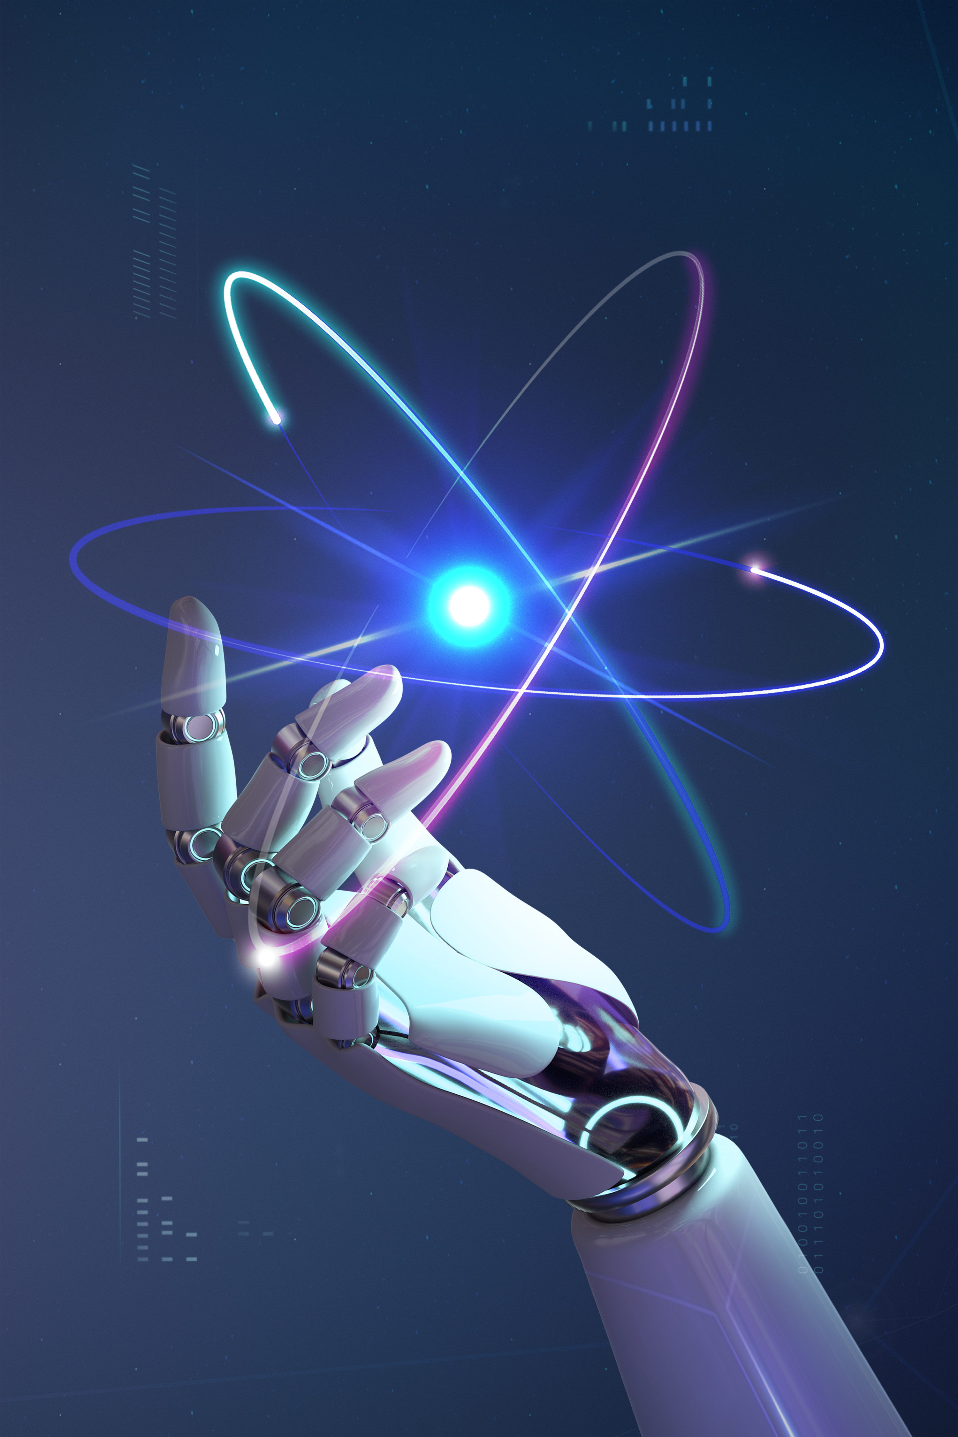
Historical Context
The Evolution of AI in Defence
Early uses of AI (Cold War, automated systems)
Recent breakthroughs in machine learning and robotics.
Milestones in AI and defence collaboration.

Slide 4
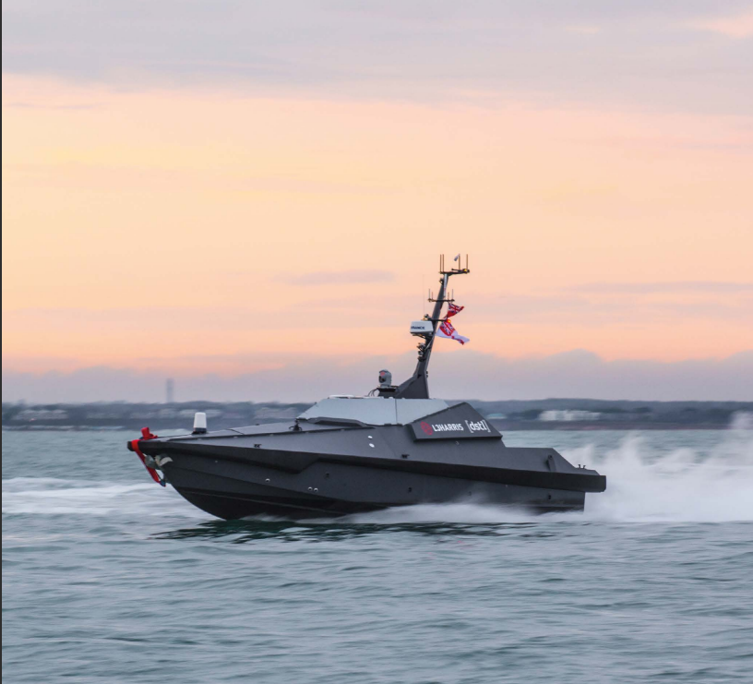
AI-Driven Autonomous Vehicles
Autonomous Systems in Defence
UAVs (Unmanned Aerial Vehicles) and drones.
Autonomous tanks and naval ships.
Benefits: Reduced human risk, 24/7 operations.
Madfox Autonomous Surface Vehicle

Slide 5
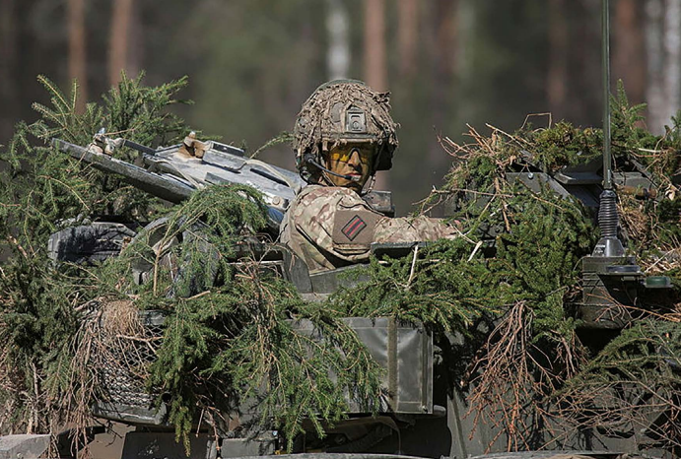
Exercise SPRING STORM – AI on the Ground
In May 2021, the British Army used AI for the first time to
assist in critical operations. A Machine Learning engine
processed vast data, reducing planning time and
providing real-time decision-making support for soldiers.

Slide 6
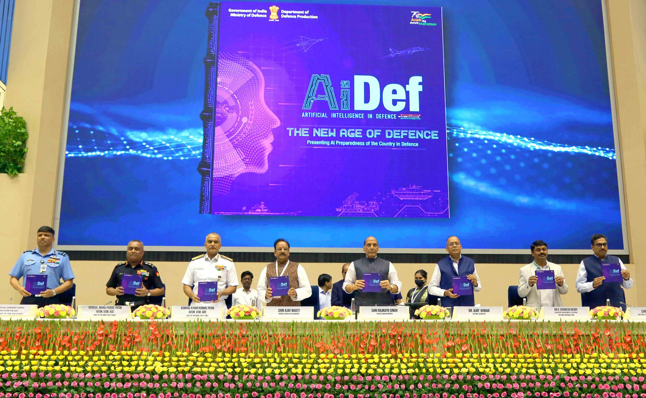
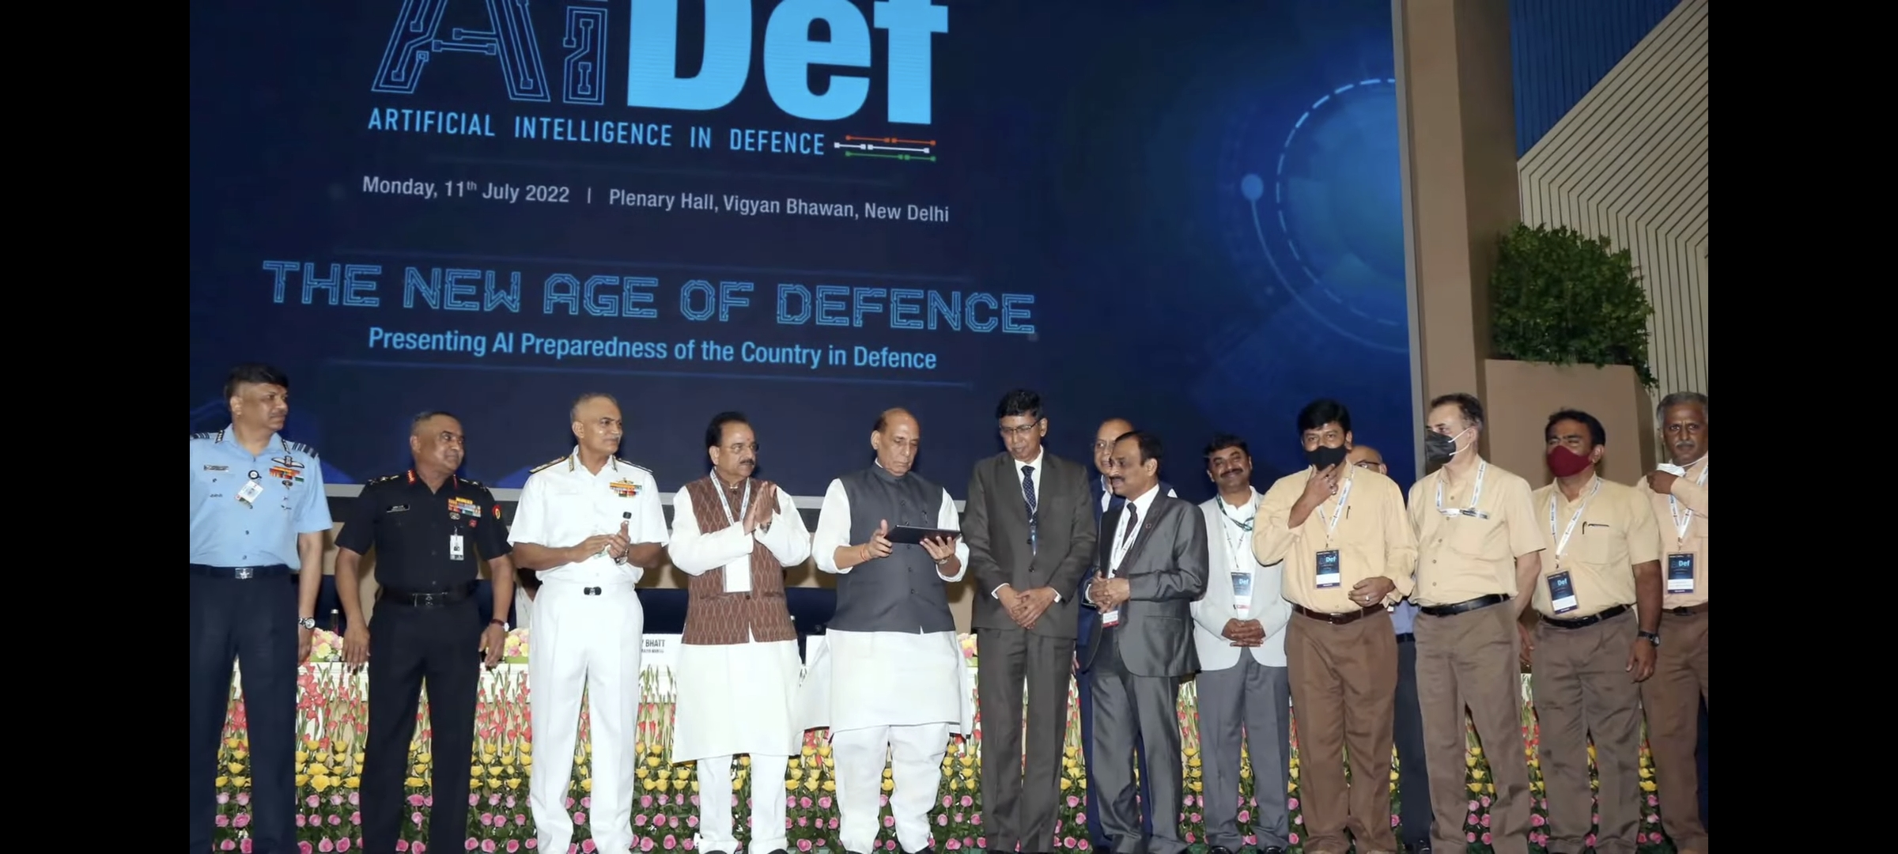
Collaborative Breakthroughs in AI: Contributions of Ministry of Defence, DRDO
Union Defence Minister Rajnath Singh launched 75 newly-developed (AI) technologies during the first-ever 'AI in Defence' (AIDef) symposium and exhibition, organised by the Ministry of Defence in New Delhi on Monday 11th July 2022.

Slide 7
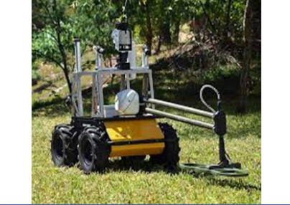
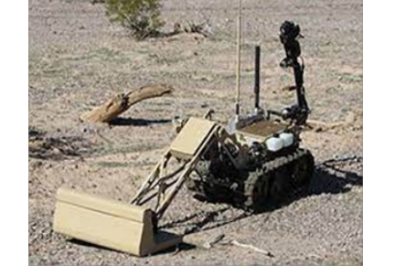
Sapper Scout – Mine Detection UGV
The "Sapper Scout" is a mine detection UGV equipped with a 5-axis robotic arm for cutting trip wires and a tracked platform for all-terrain mobility. It features three cameras for mine detection, navigation, and 360-degree environmental reconnaissance.
In the Indian Army, the existing system that is being used to carry out mine field breaching, is that of trawl tanks.

Slide 8
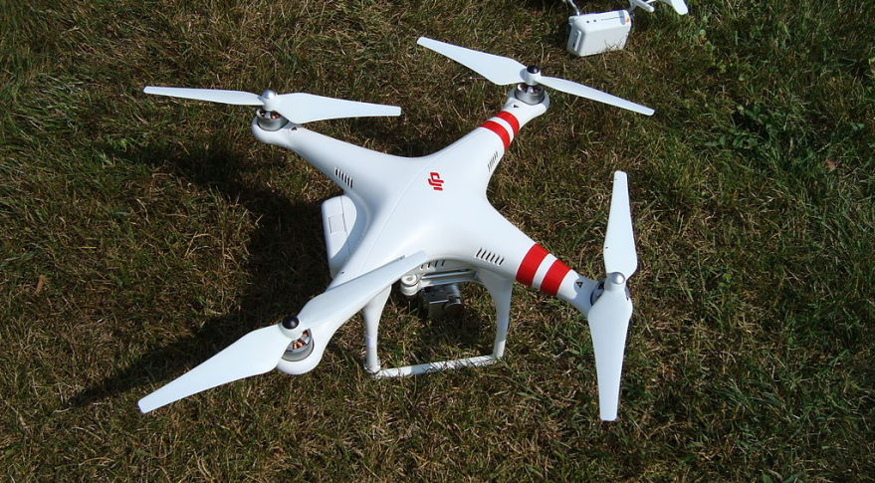
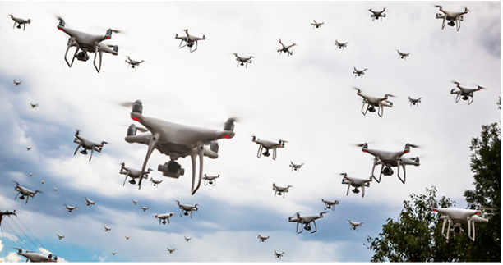
AI Capability in Swarm Drones
Drone Swarms offer aerial support for ground forces, influencing battlefield dynamics and enabling precise, flexible operations in both offensive and defensive tasks. With capabilities like Beyond Visual Line of Sight (BVLOS) attacks and reduced mission costs, they are effective for detecting and targeting enemy ground forces while minimizing human risk.

Slide 9
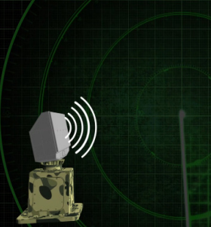
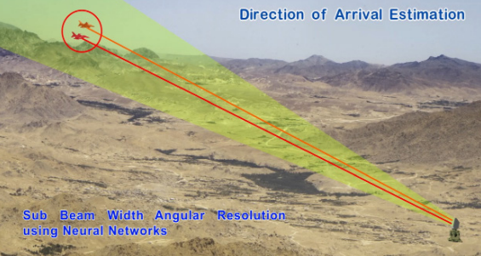
Cognitive Radar
Modern radar systems face challenges in dynamic environments, but DRDO's Young Scientist Laboratory has developed AI-driven solutions using Deep Neural Networks and Reinforcement Learning for enhanced target detection, angular estimation, and waveform adaptation. Key innovations include CNN-based target detection, Doppler compensation, and advanced algorithms for missile tracking and classification.

Slide 10
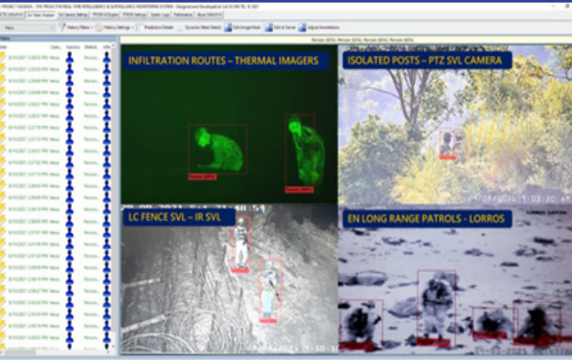
AI-Based Motion Detection & Target Identification System in LC
The Proactive Real-time Intelligence and Surveillance Monitoring System (PRISM) is the Indian Army's first AI-based system for real-time motion detection and target identification from multiple surveillance inputs. It offers real-time video analysis, multi-class object detection, night vision capabilities, and audio alerts to enhance security at critical zones like borders and counter-terrorism areas.

Slide 11
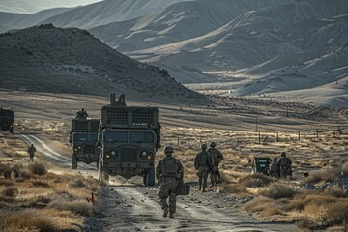
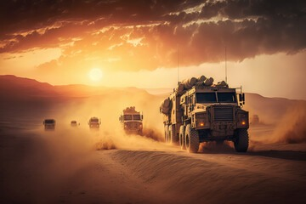
AI in Logistics and Supply Chain
Optimizing Military Resources
AI in transportation, supply management, and resource allocation.
Predictive analytics for maintenance of military assets.
Reducing waste and improving efficiency.

Slide 12
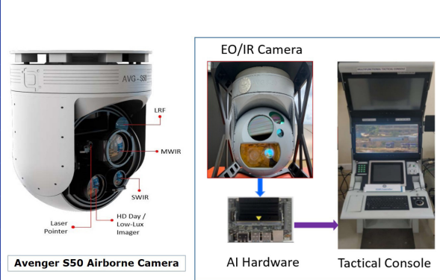
AI-Enabled Airborne Electro-Optic Infrared System
DRDO's AI-enabled Airborne Electro-Optic Infrared System utilizes advanced AI algorithms for object detection, classification, and tracking through day and thermal camera fusion. It is ideal for multi-mode maritime, coastal, and border surveillance, as well as aerial monitoring of suspicious personnel, vehicles, and objects.

Slide 13
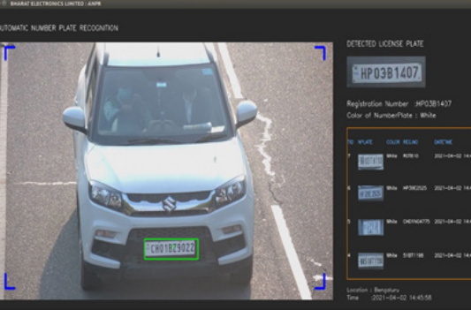
Automatic Number Plate Recognition for Smart Cities
The indigenously developed Automatic Number Plate Recognition (ANPR) system accurately detects and recognizes vehicle license plates in real-time, functioning day and night across various vehicle types. Integral to Smart City solutions, it aids in access control, traffic management, tolling, policing, and security services, enhancing automation and citizen safety.

Slide 14
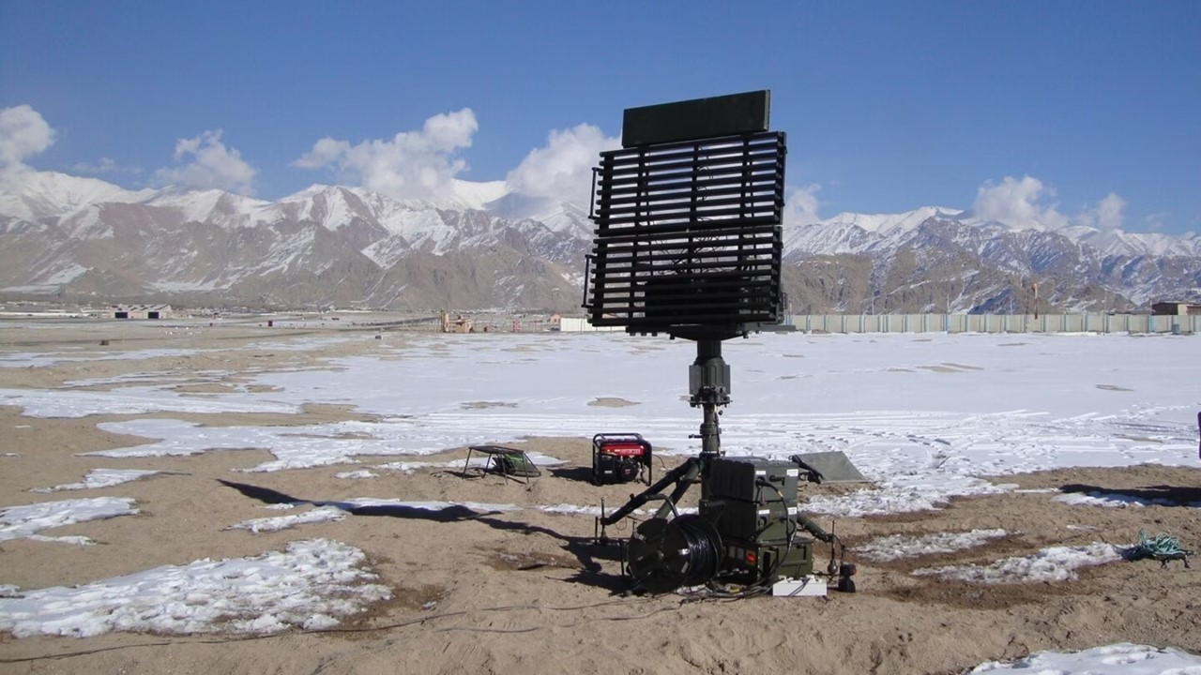
AI-Enabled Surveillance Systems
India's existing military radar
Overview: Surveillance and threat detection using AI
AI in Border Monitoring: Example of the India-Pakistan and India-China borders
Impact: Increased real-time monitoring, reduced human errors, faster decision-making
India Wants Radars to Monitor Deep Into China

Slide 15
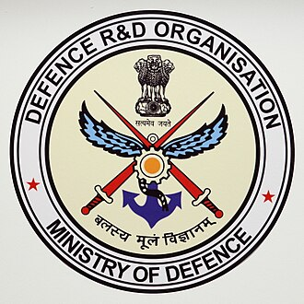
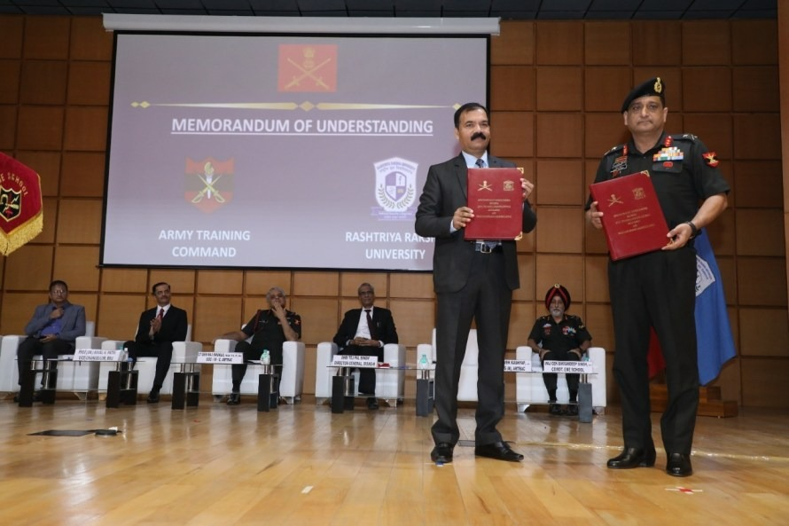
India’s AI Defence Programs & Initiatives
DRDO’s AI Research Initiatives: Autonomous systems, robotic soldiers, etc.
Ministry of Defence’s Defence AI Council: Policy framework, strategic planning for AI
Partnership with Academia & Startups: Collaborations for R&D
MoU signing with RRU Gandhinagar.

Slide 16


Global Leaders in AI DefenCe
The USA: DARPA’s AI defense programs.
China: Focus on AI-powered military innovation.
Russia: AI-enabled autonomous warfare systems.
EU (European Union): Collaborative AI defense projects.
India: Development of AI-based surveillance and defence technologies.

Slide 17
Challenges in Adopting AI in Defence
Data Security Concerns
Ethical and Legal Challenges
Budget and Infrastructure Constraints
Integration with Legacy Systems

Slide 18


Risks of AI in Defense
Potential Risks
AI system failures in critical scenarios.
Vulnerability to hacking and adversarial AI.
The risk of AI arms races between nations.
AI system failures in critical scenarios.

Slide 19



Future of AI in Defence for India
Predicted Growth: Investment in AI and robotics in defence
AI-Driven Strategic Decisions: Use of AI in intelligence and warfare strategies
Global Leadership in AI Defence Tech: India's roadmap to becoming a leader in AI for military applications

Slide 20
Conclusion
Key Takeaways
AI’s growing role in revolutionizing military strategies and operations.
The need for careful regulation and responsible use.
The potential for AI to shape the future of defence.

Slide 21
THANK YOU

